Slide 1
System Dynamics and Mechanical Vibration
If you have a smart project, you can say "I'm an engineer"
Projects
Staff boarder
Dr. Mohamed Saber Sokar
Dr. Mostafa Elsayed Abdelmonem

Slide 2
System Dynamics and Mechanical Vibration
Lecture aims:
  Formulate the equations of motion of two-degree-of-freedom systems
  Identify the mass, damping, and stiffness matrices from the equations of motion

Slide 3
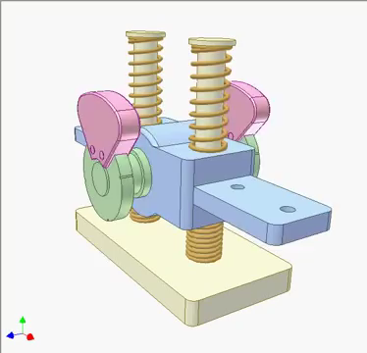
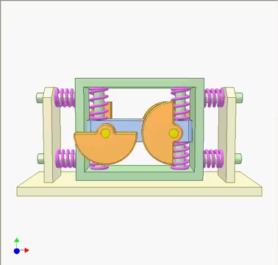
Projects

Slide 4
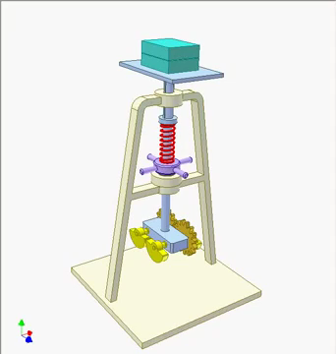
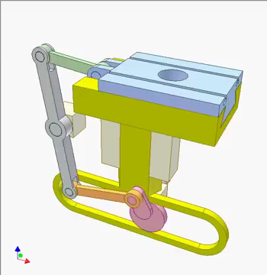
Projects

Slide 5
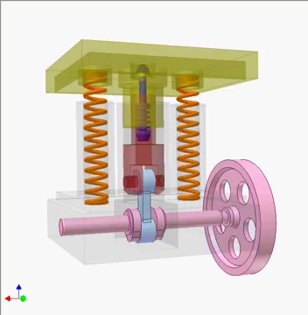
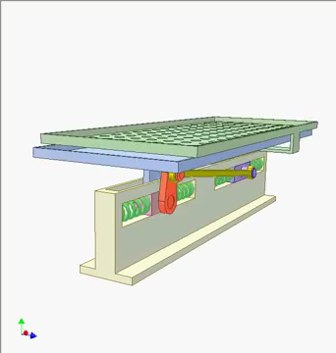
Projects

Slide 6
Program

